Slide 1
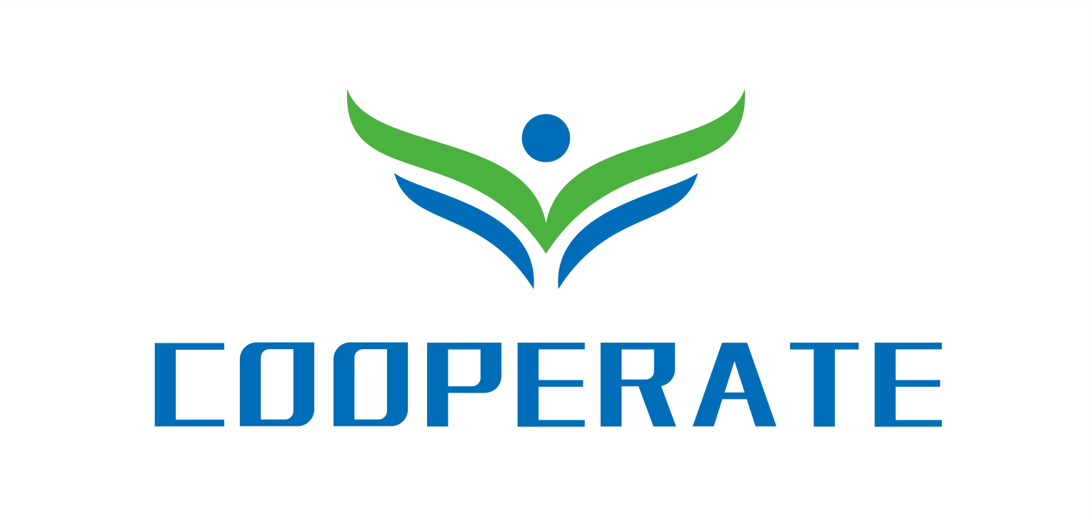
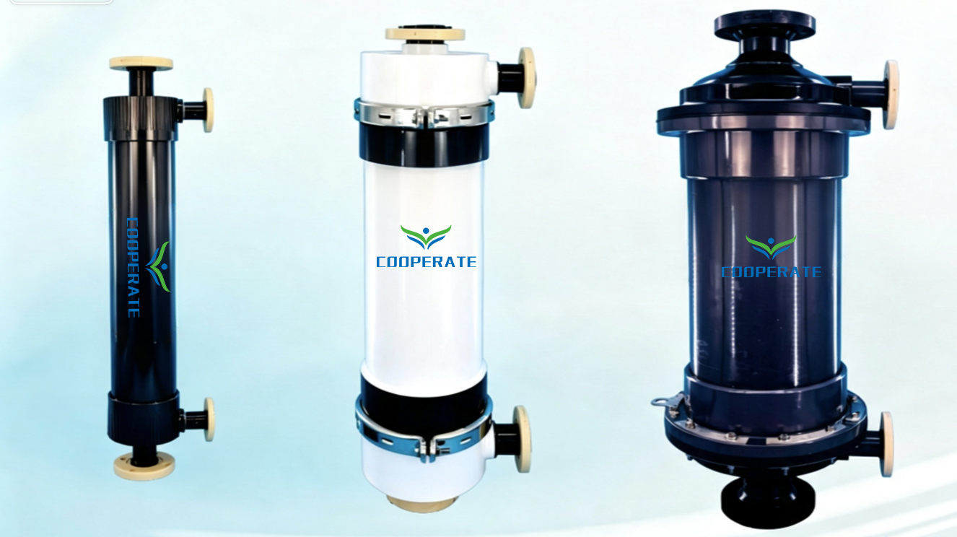
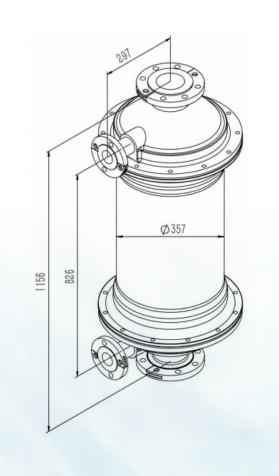
Product Description
The membrane contactor is a diffusion‑based separation device that removes dissolved gases (CO₂, O₂, NH₃) from liquids. Its hydrophobically modified hollow‑fiber membranes contain micropores that are permeable to gas but impermeable to water. Under vacuum or sweep‑gas negative pressure, dissolved gases pass through the pores into the fiber lumen and are continuously removed, thereby achieving efficient liquid degassing.
14X28
Degassing Membrane Contactor
Features and Advantages
1.Weaving layout -Hydrophobic PP hollow fibers are woven into an array and wound around a central tube.
2.Flow-guide design – Internal tube and baffles create vertical cross-flow (vs. parallel flow) for enhanced mass transfer.
3.Removal efficiency – DO ≤1 ppb, CO₂ ≤1 ppm, NH₃ ≤1 ppm.
4.Long service life – Woven array fixes filament spacing, resists impact, eliminates breakage and compression; uniform hydrophobic modification maintains performance over time.
Membrane Parameter
Model | 14X28
Membrane Material | PP
Housing Material | PVC
Flow Rate Range | 16–95 m³/h
Liquid Side Interface | JIS 100A Flange
Gas Side Interface | JIS 50A Flange
Membrane area | 225 m²
Specification
Liquid outside fibers | 5–25℃, 7.2 barg (41–77 ℉, 105 psig)
Maximum operating temperature / pressure | 50 ℃, 2.1 barg (122℉, 30 psig)
Maximum gas pressure | 4.1 bar (60 psig)
Remark | Liquid pressure should always be greater than gas pressure
Sealing Material | EPDM
Weight | Wet (liquid outside fibers)：98kg
 | Dry cartridge：62 kg
Designed in accordance with the "Standards for Drinking Water Quality" (GB 5749-2022)
Membrane Module Dimension Drawing

Slide 2
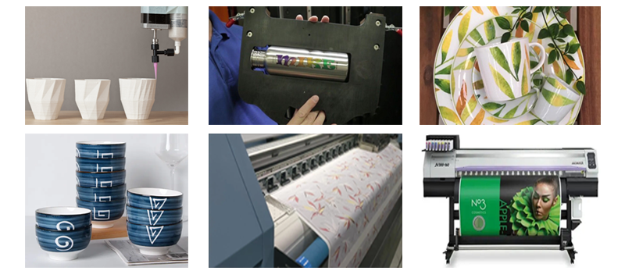
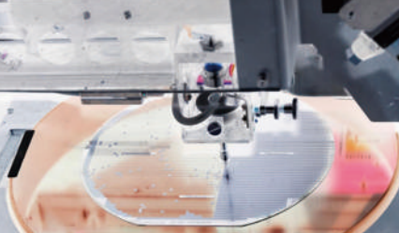
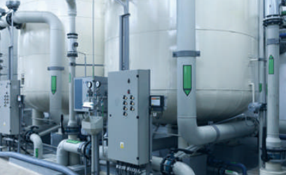
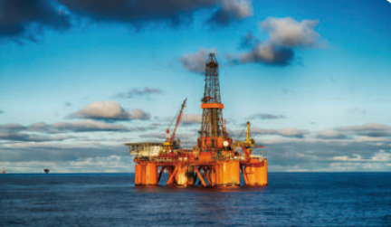
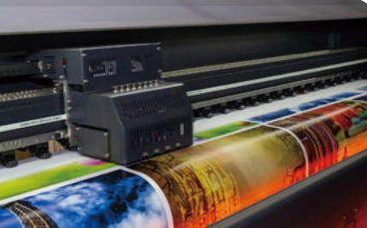
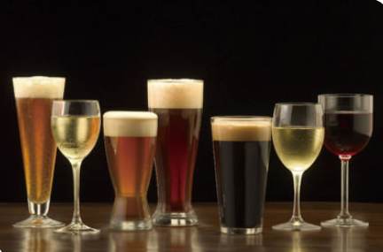
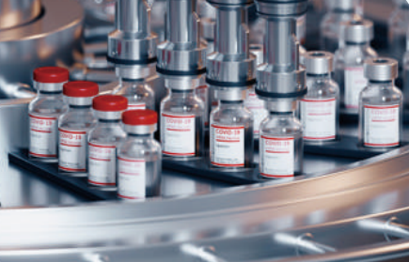

Typical Application Areas of Membrane Contactors
1. Semiconductor / Microelectronics Ultrapure Water
High levels of dissolved oxygen (DO) reduce chip and thin-film panel yield. This equipment reliably lowers DO to below 1 ppb, ensuring ultrapure water quality and guaranteeing optimal performance.
2. Boiler Feed Water
Replaces traditional amine-based deoxygenation with an eco-friendly, pollution-free alternative. It pre-removes O₂ and CO₂ from feedwater, preventing boiler and pipeline corrosion and extending boiler service life.
3. Oilfield Re-Injection Water
Dissolved oxygen, CO₂, and H₂S in the water corrode pipelines and cause scale formation. Membrane contactors remove these dissolved gases, protecting the reservoir and enhancing crude oil recovery.
4. Inkjet Ink Degassing
Eliminates bubbles within the ink, preventing nozzle clogging, ink starvation, and poor droplet formation during printing. It stabilizes print clarity and is ideally suited for continuous inline degassing lines.
5. Food and Beverage Industry
Controls dissolved oxygen content in beer and beverages, extending shelf life, preserving natural flavor, and preventing oxidation and spoilage.
6. Pharmaceutical Pure Water
Removes CO₂ from water, lowering product water conductivity to meet pharmaceutical-grade standards (< 1.3 µS/cm), and producing high-purity, impurity-free process water.
WhatsApp：+86 15556910898
Email Address：boruike15@gmail.com
Please visit our website：www.coopmem.com
Company Address：Building 17, Hefei Hi-Tech International Enterprise Port,
Liandong U Valley, No. 2899 Kongquetai Road, Hefei Hi-Tech Zone, Hefei, China

