Slide 1
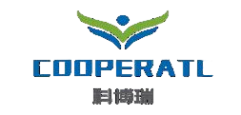
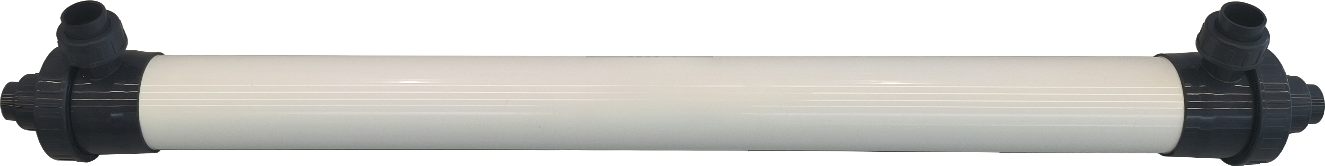
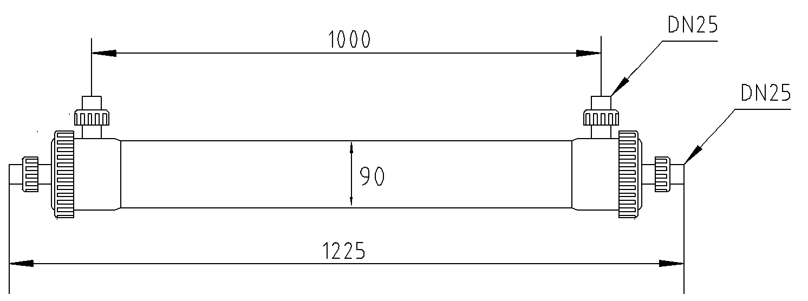
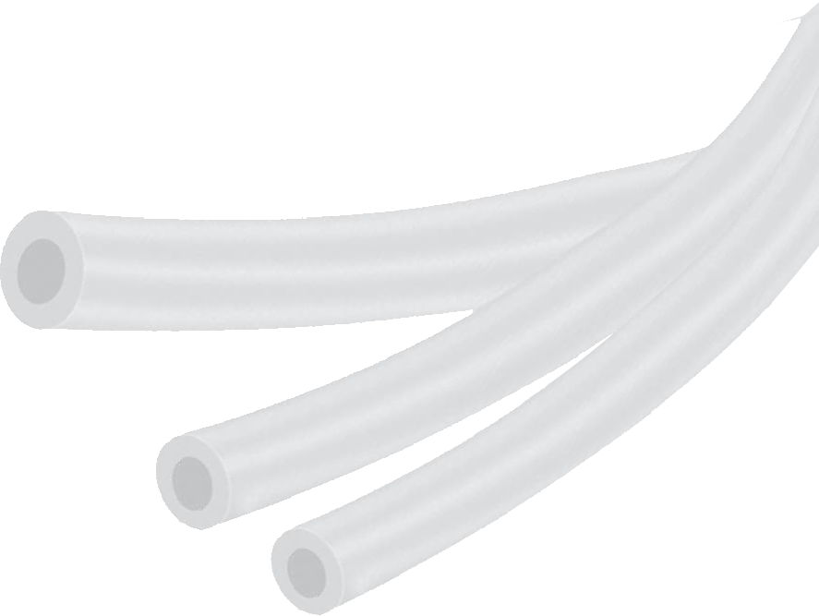
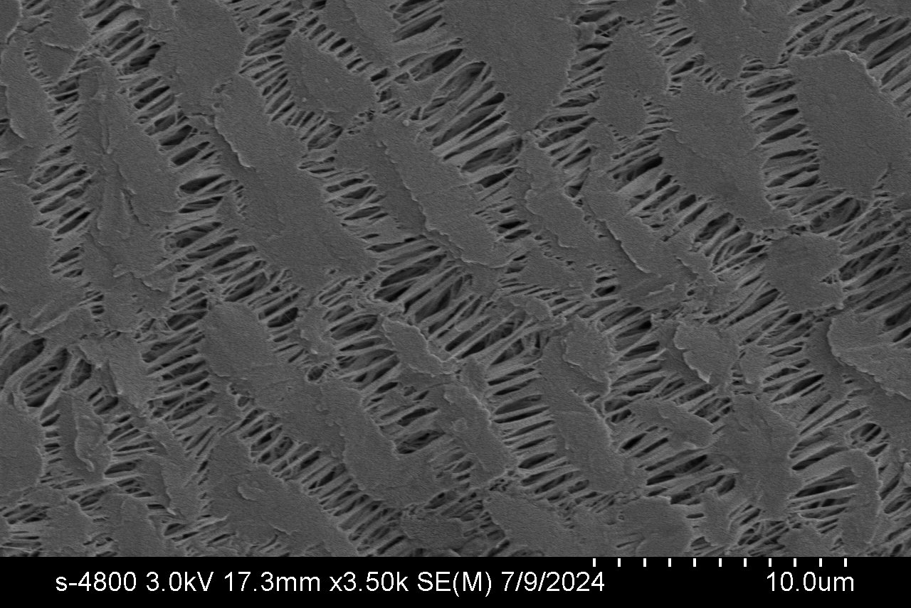
Product description
Cooperate has developed a membrane contactor using PTFE hollow fiber membrane for efficient and cost-effective ammonia nitrogen removal.
PTFE-TMCS-4040 Membrane Contactor
Features and advantages
Efficient removal of ammonia nitrogen-
Operates at near-normal pressure with low energy consumption and minimal operating costs
Providing corrosion resistance, high resistance to strong acids and alkalis, high-temperature resistance, strong hydrophobicity, and a long service life
Possesses uniform pores and a narrow pore size distribution to prevent concentration polarization and scaling
Strong resistance to fluid impact, eliminating the risk of broken fibers
Material
Components | Material
shell | UPVC
Membrane | PTFE
Sealing ring | EPMD
Potting | Epoxy resin
Specification
Membrane area | 12m²
Membrane pore size | 0.1μm​
Design water flow | 50-150L/h
Design water inlet pressure | 0.02-0.05MPa
Design water inlet temperature | 35-45 ℃
Design inlet water pH | ＞11
Design acid inlet pressure | 0.02-0.05MPa
Design acid inlet temperature | 5-45℃
Design acid inlet pH | 1-2
Membrane 3D drawing and
3000 times electron microscope image of the inner surface

Slide 2
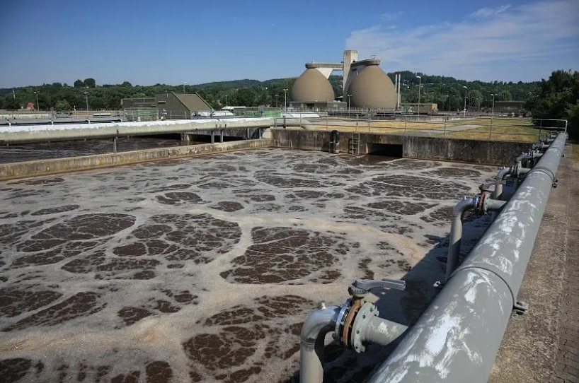
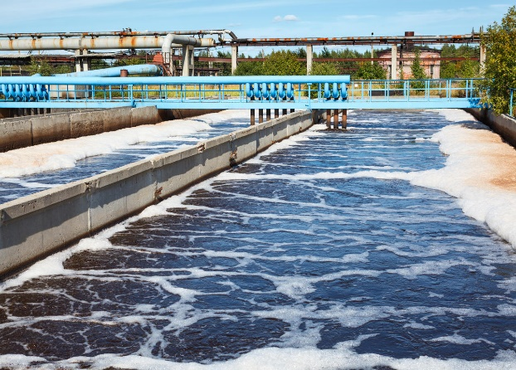
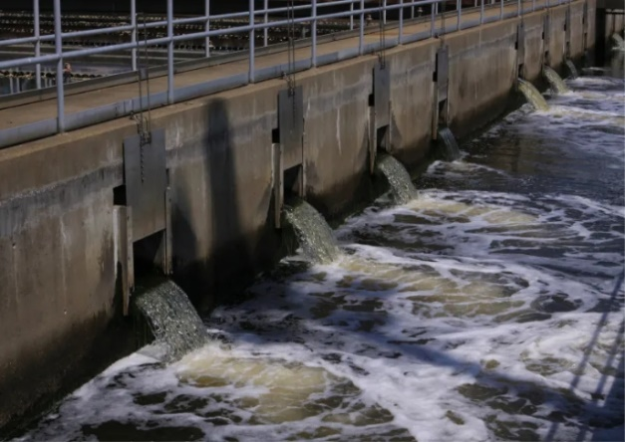
Note: The ammonia nitrogen content of the raw water is 2076ppm, pH=12.18, the raw water temperature is raised to 45℃, and the pH value of the sulfuric acid absorption liquid is maintained below 1. The above test data is the removed racial average level curve of ammonia nitrogen wastewater passing through the deammoniation membrane shell, and the individual deviation of the membrane contactor from the average level is within ±3%.
Note: The ammonia nitrogen content of the raw water is 2076ppm, pH=12.18, the raw water temperature is raised to 45℃, and the pH value of the sulfuric acid absorption liquid is maintained below 1. The above test data is the removed racial average level curve of ammonia nitrogen wastewater passing through the deammoniation membrane lumen side, and the individual deviation of the membrane contactor from the average level is within ±3%.
Applications
Removal of ammonia nitrogen from ternary precursor and semiconductor wastewater.
Chemical, pharmaceutical, pesticide, metallurgy, municipal sewage, and landfill leachate.
Extraction of bromine from seawater, concentrated seawater, underground brine, chemical feed liquid, etc.
Company Name：Anhui Cooperate Environmental Technology Co., Ltd.
Company Address： Building 17, Liandong U Valley Hefei High-tech International Enterprise Port, No. 2899 Kongquetai Road, Hefei High-tech Zone, Hefei, China
Please visit our website：www.coopmem.com

